Slide 1
Shortcut key
Command + shift + arrow
Function
= SUMIF(A1:A10,”User”,B1:B10)
= IF(logical_test, [value_if_true], [value_if_false])
= IF(A1<10, “low”, IF(A1<20, “middle”, “high”))
= VLOOKUP(lookup_value, table_array, col_index_num, False/True) 精确/模糊
= HLOOKUP(lookup_value, table_array, row_index_num, False/True) 精确/模糊
= RANDBETWEEN(1,4)

Slide 2
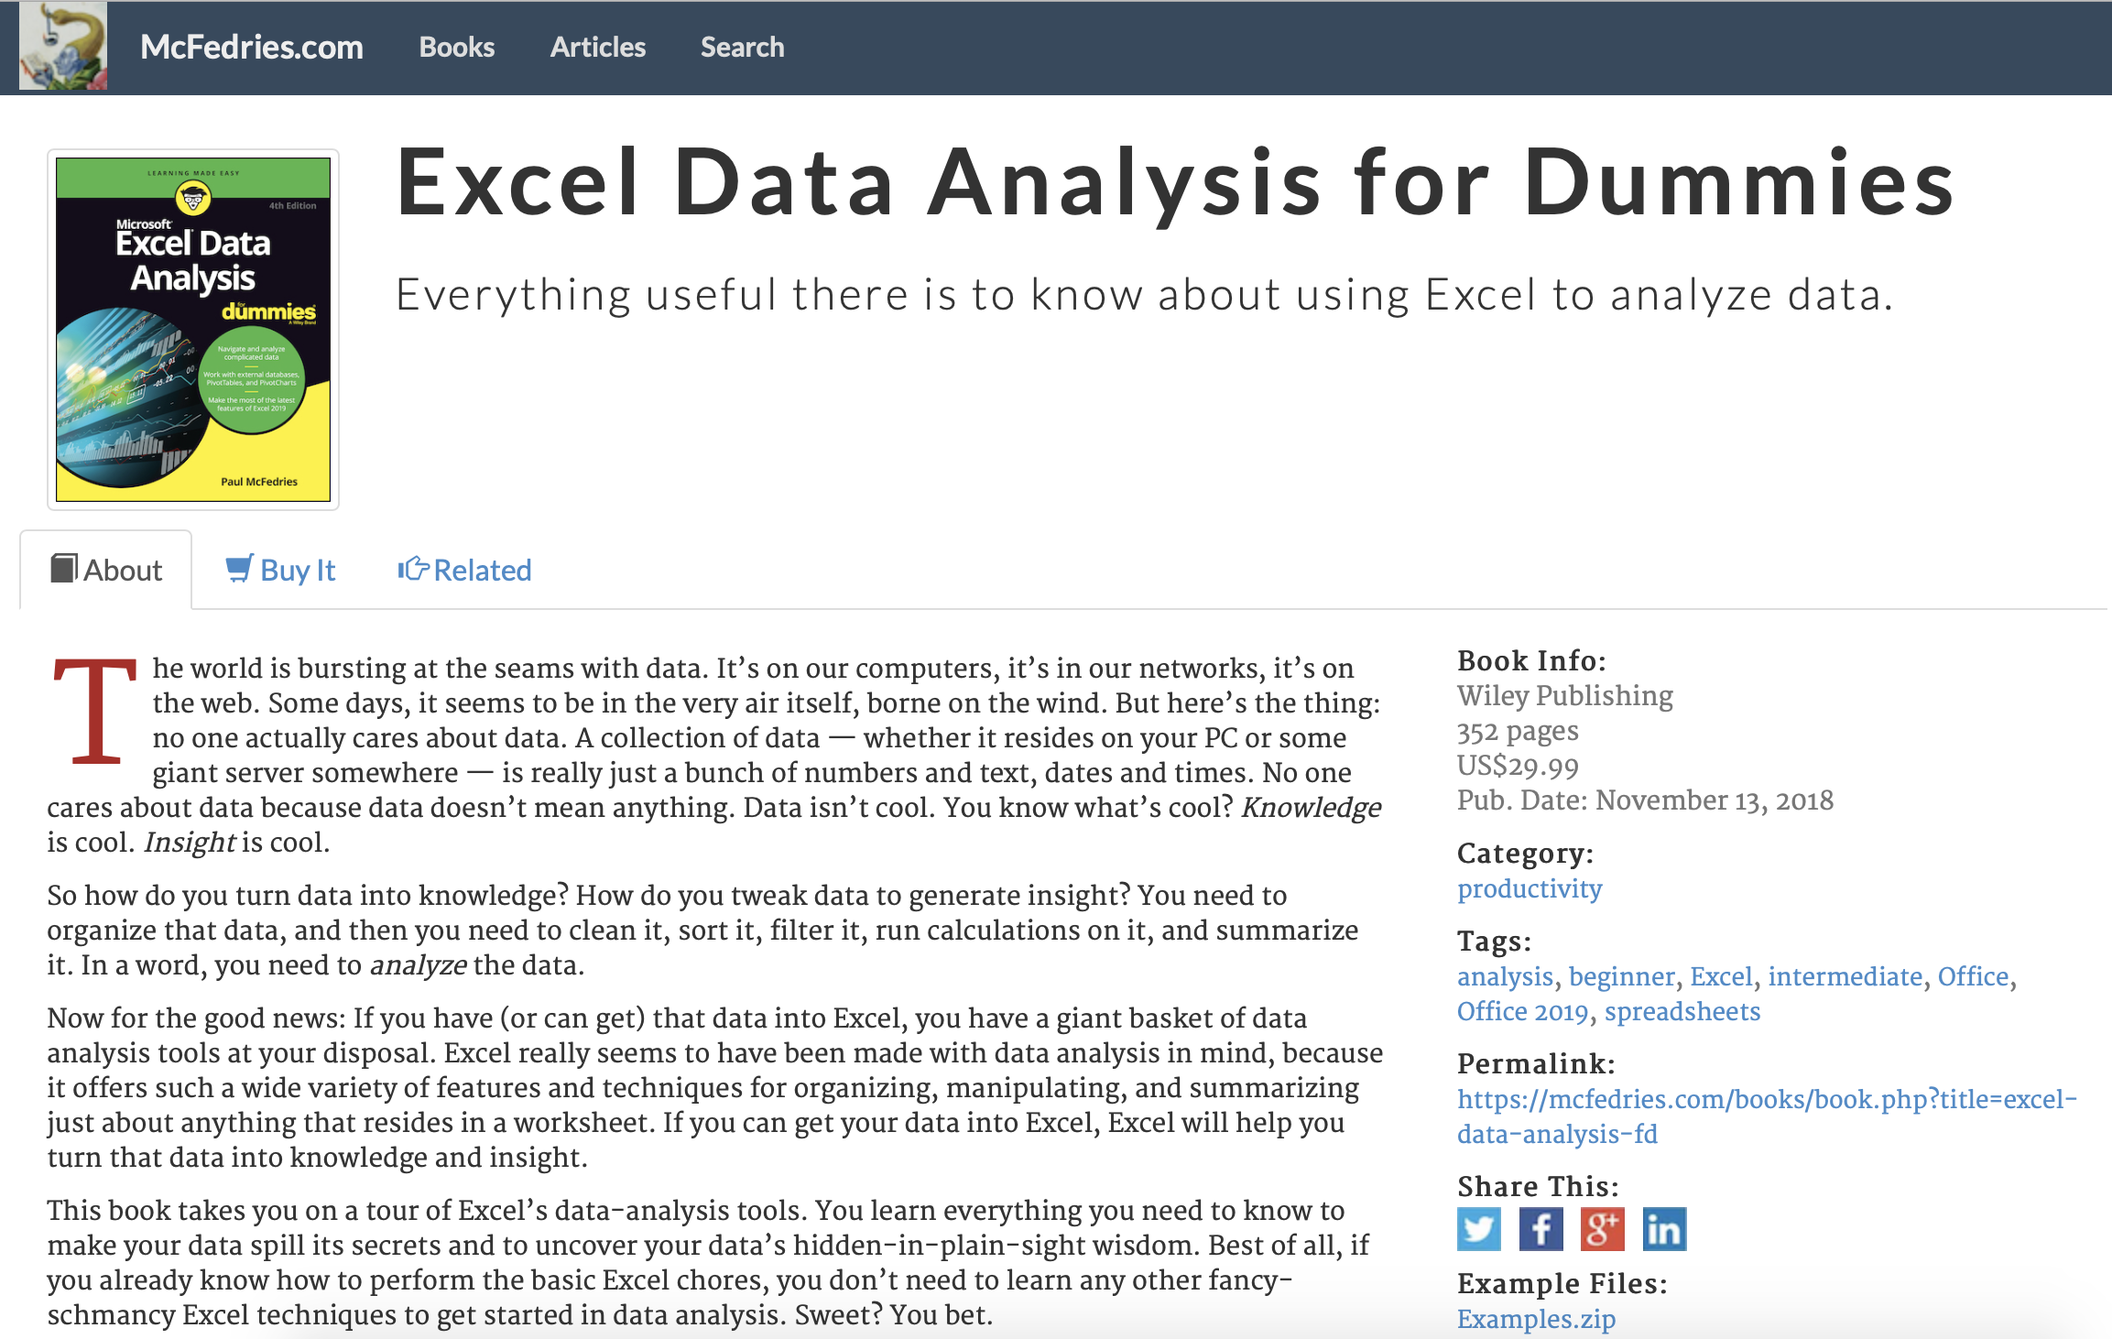
Excel Data Analysis for dummies
Studying Note
https://www.mcfedries.com/books/book.php?title=excel-data-analysis-fd
Click here to download the practice data

Slide 3
Chapter 1 Learning Basic Data-analysis Techniques
Analyzing Data with Conditional Formatting
Highlighting cells that meet some criteria
Showing pesky duplicate values
Highlighting the top or bottom values in a range
Analyzing cell values with data bars
Analyzing cell values with color scales
Analyzing cell values with icon sets
Summarizing Data with Subtotals
Grouping Related Data
Consolidating Data from Multiple Worksheets (Combining multiple worksheets into a summary report.)
Consolidating by position: Worksheets we’re consolidating have an identical layout.
Consolidating by category: Worksheets we’re consolidating have different layouts but common labels.

Slide 4
Chapter 2 Working with Data-Analysis Tools
Working with Data Tables
Data table is special range that excel uses to calculate multiple solutions to a formula.
One-input data table
Analyzing Data with Goal Seek
Analyzing Data with Scenarios
Optimizing Data with Solver
Con
Co

